Slide 1


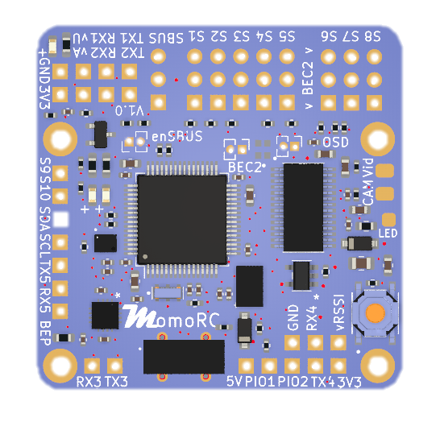
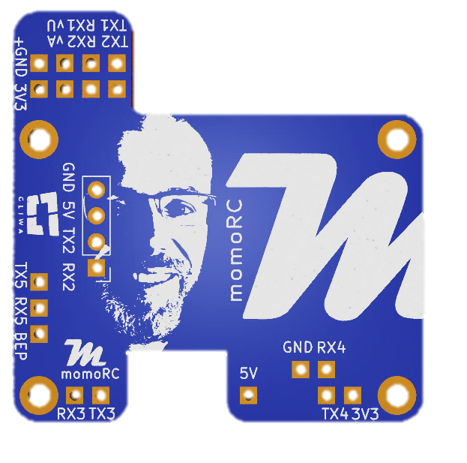
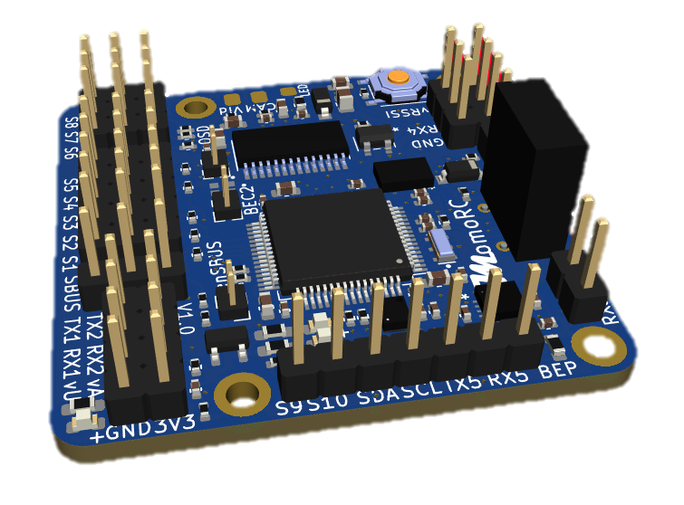
FLIGHT CONTROLLER MOMOFC-1
STM32F405RGT6, BMI088, HMC5883L, DPS310, OSD, 5x UARTs, 1x I2C, 10x PWM, Dual BEC support, 2~5S LiPo
omoRC
Features
Specifications
Power
Firmware
Physical
STM32F405RGT6, 1MB flash
6-axis inertial sensor (IMU)
Barometer and magnetometer
5V BEC input
Dual BEC capable (selectable): BEC1: S1-S5 or S1-S8, BEC2: S6-S8
Analog VTX overlay.
max. 6 motors + 3servos in INAV/BF multirotor mixer.
DJI HD System support (Caddx Vista & Air Unit)
SBUS support (selectable, RX2)
USB-C
Protection/extender PCBs
No BlackBox (Flash/SD)
MCU: STM32F405RGT6
IMU: BOSCH BM088
Magnetometer: HMC5883L
OSD: AT7456E, DJI OSD
Baro: Infineon DPS310 (I2C)
5x UARTs (eg. RX, SBUS, DJI, ESC telemetry), 1x Softserial_Tx option
10x PWM outputs (6x Dshot)
1x I2C
4x ADC (VBAT, Current, RSSI, Airspeed)
2x PINIO
3x LEDs for FC STATUS (Blue, Green) and 3.3V indicator (Red)
RGB led support (WS2812)
Input: 5V (from BEC or MomoRC adapter board)
LDO: 3.3V 600mA
Battery Voltage sensing: 2K:12K (INAV scale 700)
Supports external current sensor
INAV: MOMOFC
BetaFlight: COMPILEYOURSELF
Mounting: 25/35 x 35mm, Φ2.5mm
Dimensions: 40 x 40 x 5 mm
Weight: 7g
omoRC 2022
V1.0, 22.10.2022

Slide 2
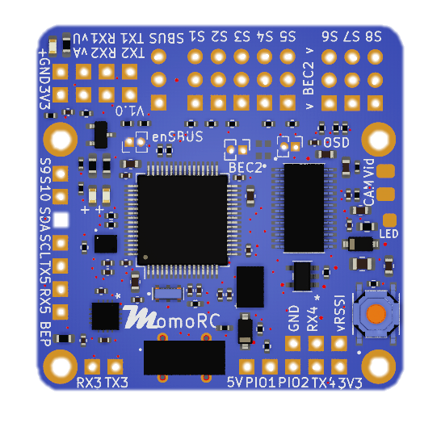

FLIGHT CONTROLLER MOMOFC-1
STM32F405RGT6, BMI088, HMC5883L, DPS310, OSD, 5x UARTs, 1x I2C, 10x PWM, Dual BEC support, 2~5S LiPo
FLIGHT CONTROLLER MOMOFC-1
STM32F405RGT6, BMI088, HMC5883L, DPS310, OSD, 5x UARTs, 1x I2C, 10x PWM, Dual BEC support, 2~5S LiPo
omoRC
Layout
Base module
vU: battery voltage (max 3.6V, ADC1), DC 8~25V (2S~5S) , INAV scale 700 [2K:12K]
vA: current sensor signal (max 3.6V, ADC2)
Led 0: Red, 3.3V
SBUS port enable:
UART2 (inverted) on SBUS port
BEC2: bridges 5V rail S1-5 and S6-8
OSD enable (3V3)
VID: analog video out
CAM: camera in
LED: 2812 LED signal out
Led 1: Blue, FC Status
Led 2: Green, FC Status
Analog OSD
AT7456E
STM32F405 RGT6
SCL/SDA: I2C1
Baro
LDO
500mA
Assembly Dir
Forward facing
(Recommended)
IMU
Button:
STM32 boot pin
DFU mode: press on power-on
BEP: buzzer signal
(3V3, max 20mA)
MAG
USB-C 2.0
vAIR on backside: analog air speed sensor (max 3.3V, ADC4)
PIO1, PIO2: PINIO, SW switched pins
vRSSI RSSI sensor signal (max 3.3V, ADC3)
omoRC 2022
V1.0, 22.10.2022

Slide 3
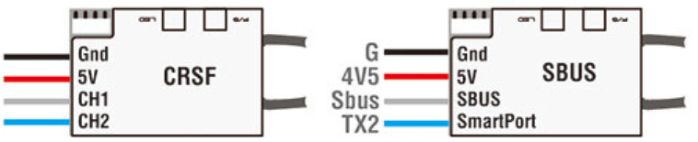
FLIGHT CONTROLLER MOMOFC-1
STM32F405RGT6, BMI088, HMC5883L, DPS310, OSD, 5x UARTs, 1x I2C, 10x PWM, Dual BEC support, 2~5S LiPo
FLIGHT CONTROLLER MOMOFC-1
STM32F405RGT6, BMI088, HMC5883L, DPS310, OSD, 5x UARTs, 1x I2C, 10x PWM, Dual BEC support, 2~5S LiPo
omoRC
INAV Config
Receiver Wiring
UARTS/Receiver:
UART1: USER defined
UART2: Receiver
a) CRSF: RX2/TX2
b) FRSKY SBUS: SBUS RX: RX: "SBUS"-PAD(= invert.RX2), connect to receiver SBUS (!enable SBUS jumper)
SPORT telemetry: TX2: remap TX2 to ‚Softserial_TX1‘ for telemetry, INAV "enable Softserial_Tx1"
c) FRSKY FPORT: TX2: to FPORT, uninverted S.Port/F.Port signal (hacked)
UART3: USER defined, RX3 for BLHeli32 ESC telemetry
UART4: DJI OSD
UART5: GPS
Battery Voltage:
INAV scale 700 [2K:12K]
vU: battery voltage (max 3.6V, ADC1), DC 8~25V (2S~5S)
DSHOT:
With INAV firmware, DSHOT can not work on S3, S5,S7 because of DMA clash, pls use ONESHOT or MULTISHOT and calibrate ESC PWM range.
Magnetometer:
HMC5883L (autodetected)
Barometer/Vario:
Infineon DPS310 (autodetected)
GND
5V
RX2
TX2
GND
5V
SBUS
TX2
!!! Only works with uninverted F.PORT/S.PORT
omoRC 2022
V1.0, 22.10.2022

Slide 4


Assembly Notes IMU config (INAV)
FLIGHT CONTROLLER MOMOFC-1
STM32F405RGT6, BMI088, HMC5883L, DPS310, OSD, 5x UARTs, 1x I2C, 10x PWM, Dual BEC support, 2~5S LiPo
omoRC
Assembly Dir
Forward facing
(Recommended)
Check magnetometer alignment (CLI):
align_mag = CW0 align_mag_roll = 0 align_mag_pitch = 0 align_mag_yaw = 0
Check board alignment (CLI): align_board_roll = 0 align_board_pitch = 0 align_board_yaw = 0
omoRC 2022
V1.0, 22.10.2022

Slide 5







Software Documentation
FLIGHT CONTROLLER MOMOFC-1
STM32F405RGT6, BMI088, HMC5883L, DPS310, OSD, 5x UARTs, 1x I2C, 10x PWM, Dual BEC support, 2~5S LiPo
omoRC
Target.h
Target.c
Config.h
Tasks.json
INAV Configurator
omoRC 2022
V1.0, 22.10.2022

Slide 6
How to build for INAV INAV releases Build Environment Prepare Build Customize own target Build/make Initial Flashing
FLIGHT CONTROLLER MOMOFC-1
STM32F405RGT6, BMI088, HMC5883L, DPS310, OSD, 5x UARTs, 1x I2C, 10x PWM, Dual BEC support, 2~5S LiPo
omoRC
INAV project:
https://github.com/iNavFlight/inav
INAV Releases:
INAV: https://github.com/iNavFlight/inav/releases
INAV Configurator: https://github.com/iNavFlight/inav-configurator/releases
Build environment setup
see actual INAV versions specifics in …
https://github.com/iNavFlight/inav/tree/master/docs/development
„Building in Windows 10 or 11 with Linux Subsystem.md”
„IDE - Visual Studio Code with Windows 10.md“
Prepare your build : : Git clone or download INAV (any release)
Customize/define your own version of MomoFC in INAV:
a) Copy existing/closest matching target (MATEK F405HD) folder to new <myFCName> folder in /src/main/targets
b) Adapt the following files: (working example see next slides)
- target.c
- target.h
- config.h
Prepare for building:
a) Create own build task (see example)
b) update cmake environment: start „cmake ..“ in /build
c) „make <targetName>
Initial Flashing a new Flight Controller:
Flash own target build on untouched FC with STM Cube Programmer
omoRC 2022
V1.0, 22.10.2022

Slide 7
INAV target config.h
FLIGHT CONTROLLER MOMOFC-1
STM32F405RGT6, BMI088, HMC5883L, DPS310, OSD, 5x UARTs, 1x I2C, 10x PWM, Dual BEC support, 2~5S LiPo
omoRC
Config.h:
#pragma once
#define USE_TARGET_CONFIG
# define TARGET_BOARD_IDENTIFIER "MOFC„ // 4 Bytes !!!
# define USBD_PRODUCT_STRING "MomoFC405"
#define LED0 PA14 //Blue
#define LED1 PA13 //Green
#define BEEPER PB9
#define BEEPER_INVERTED
#define BEEPER_PWM_FREQUENCY 2500
// *************** SPI1 IMU & OSD *******************
#define USE_SPI
#define USE_SPI_DEVICE_1
#define SPI1_SCK_PIN PA5
#define SPI1_MISO_PIN PA6
#define SPI1_MOSI_PIN PA7
#define USE_IMU_BMI088
#define IMU_BMI088_ALIGN CW0_DEG
#define BMI088_SPI_BUS BUS_SPI1
#define BMI088_GYRO_CS_PIN PC7
#define BMI088_ACC_CS_PIN PC14
#define GYRO_INT_EXTI PC15
#define BMI088_EXTI_PIN GYRO_INT_EXTI
#define USE_EXTI
#define USE_MPU_DATA_READY_SIGNAL
#define USE_MAX7456
#define MAX7456_SPI_BUS BUS_SPI1
#define MAX7456_CS_PIN PB12
// *************** SPI2 Flash/SD Card ****************
// deleted
// *************** I2C /Baro/Mag *********************
#define USE_I2C
#define USE_I2C_DEVICE_1
#define I2C1_SCL PB8
#define I2C1_SDA PB7
#define USE_BARO
#define BARO_I2C_BUS BUS_I2C1
#define USE_BARO_BMP280
#define USE_BARO_MS5611
#define USE_BARO_DPS310
#define USE_BARO_SPL06
#define USE_MAG
#define MAG_I2C_BUS BUS_I2C1
#define USE_MAG_HMC5883
#define USE_MAG_QMC5883
#define USE_MAG_IST8310
#define USE_MAG_IST8308
#define USE_MAG_MAG3110
#define USE_MAG_LIS3MDL
#define USE_RANGEFINDER
#define RANGEFINDER_I2C_BUS BUS_I2C1
#define PITOT_I2C_BUS BUS_I2C1
#define TEMPERATURE_I2C_BUS BUS_I2C1
#define BNO055_I2C_BUS BUS_I2C1
// *************** UART *****************************
#define USE_VCP
#define USE_UART1
#define UART1_TX_PIN PA9
#define UART1_RX_PIN PA10
#define USE_UART2
#define UART2_TX_PIN PA2
#define UART2_RX_PIN PA3
#define USE_UART3
#define UART3_TX_PIN PC10
#define UART3_RX_PIN PC11
#define USE_UART4
#define UART4_TX_PIN PA0
#define UART4_RX_PIN PA1
#define USE_UART5
#define UART5_TX_PIN PC12
#define UART5_RX_PIN PD2
#define USE_SOFTSERIAL1
#define SOFTSERIAL_1_TX_PIN PA2
#define SOFTSERIAL_1_RX_PIN PA2
#define SERIAL_PORT_COUNT 7 // VCP, UART1,2,3,4,5, Softserial
#define DEFAULT_RX_TYPE RX_TYPE_SERIAL
#define SERIALRX_PROVIDER SERIALRX_CRSF
#define SERIALRX_UART SERIAL_PORT_USART2
// *************** ADC ***************************
#define USE_ADC
#define ADC_INSTANCE ADC1
#define ADC1_DMA_STREAM DMA2_Stream4
#define ADC_CHANNEL_1_PIN PC4
#define ADC_CHANNEL_2_PIN PC5
#define ADC_CHANNEL_3_PIN PB0
#define ADC_CHANNEL_4_PIN PC0
#define VBAT_ADC_CHANNEL ADC_CHN_1
#define CURRENT_METER_ADC_CHANNEL ADC_CHN_2
#define RSSI_ADC_CHANNEL ADC_CHN_3
#define AIRSPEED_ADC_CHANNEL ADC_CHN_4
// *************** PINIO ***************************
#define USE_PINIO
#define USE_PINIOBOX
#define PINIO1_PIN PC1
#define PINIO2_PIN PC2
// *************** LEDSTRIP ************************
#define USE_LED_STRIP
#define WS2811_PIN PB1
// *************** others ************************
#define DEFAULT_FEATURES (FEATURE_OSD | FEATURE_TELEMETRY | FEATURE_CURRENT_METER | FEATURE_VBAT | FEATURE_TX_PROF_SEL
#define VBAT_SCALE_DEFAULT 700
#define CURRENT_METER_SCALE 150
#define TARGET_IO_PORTA 0xffff
#define TARGET_IO_PORTB 0xffff
#define TARGET_IO_PORTC 0xffff
#define TARGET_IO_PORTD (BIT(2))
#define MAX_PWM_OUTPUT_PORTS 10
#define USE_SERIAL_4WAY_BLHELI_INTERFACE
#define USE_DSHOT
#define USE_ESC_SENSOR
omoRC 2022
V1.0, 22.10.2022

Slide 8
INAV target config.c target.c
FLIGHT CONTROLLER MOMOFC-1
STM32F405RGT6, BMI088, HMC5883L, DPS310, OSD, 5x UARTs, 1x I2C, 10x PWM, Dual BEC support, 2~5S LiPo
omoRC
config.c:
void targetConfiguration(void)
{
pinioBoxConfigMutable()->permanentId[0] = BOX_PERMANENT_ID_USER1;
pinioBoxConfigMutable()->permanentId[1] = BOX_PERMANENT_ID_USER2;
beeperConfigMutable()->pwmMode = true;
}
Target.c:
timerHardware_t timerHardware[] = {
DEF_TIM(TIM8, CH4, PC9, TIM_USE_MC_MOTOR | TIM_USE_FW_MOTOR, 0, 0), // S1 D(2,7,7) UP217
DEF_TIM(TIM8, CH3, PC8, TIM_USE_MC_MOTOR | TIM_USE_FW_MOTOR, 0, 0), // S2 D(2,2,0) UP217
DEF_TIM(TIM1, CH3N, PB15, TIM_USE_MC_MOTOR | TIM_USE_FW_SERVO, 0, 0), // S3 D(2,6,0) UP256
DEF_TIM(TIM1, CH1, PA8, TIM_USE_MC_MOTOR | TIM_USE_FW_SERVO, 0, 1), // S4 D(2,1,6) UP256
DEF_TIM(TIM2, CH4, PB11, TIM_USE_MC_MOTOR | TIM_USE_FW_SERVO, 0, 0), // S5 D(1,7,3) UP173
DEF_TIM(TIM2, CH3, PB10, TIM_USE_MC_MOTOR | TIM_USE_FW_SERVO, 0, 0), // S6 D(1,1,3) UP173
DEF_TIM(TIM2, CH2, PB3, TIM_USE_MC_MOTOR | TIM_USE_FW_SERVO, 0, 0), // S7 D(1,6,3) UP173
DEF_TIM(TIM2, CH1, PA15, TIM_USE_MC_MOTOR | TIM_USE_FW_SERVO, 0, 0), // S8 D(1,5,3) UP173
DEF_TIM(TIM12, CH1, PB14, TIM_USE_MC_SERVO | TIM_USE_FW_SERVO, 0, 0), // S9 DMA NONE
// DEF_TIM(TIM13, CH1, PA6, TIM_USE_MC_SERVO | TIM_USE_FW_SERVO, 0, 0), // S10 DMA NONE
DEF_TIM(TIM4, CH1, PB6, TIM_USE_MC_SERVO | TIM_USE_FW_SERVO, 0, 0), // S10 D(1,0,2)
DEF_TIM(TIM3, CH4, PB1, TIM_USE_LED, 0, 0), // 2812LED D(1,2,5)
DEF_TIM(TIM11, CH1, PB9, TIM_USE_BEEPER, 0, 0), // BEEPER PWM
DEF_TIM(TIM9, CH2, PA3, TIM_USE_PPM, 0, 0), //RX2
DEF_TIM(TIM5, CH3, PA2, TIM_USE_ANY, 0, 0), //TX2 softserial1_Tx
};
const int timerHardwareCount = sizeof(timerHardware) / sizeof(timerHardware[0]);
omoRC 2022
V1.0, 22.10.2022

Slide 9
INAV target build task
FLIGHT CONTROLLER MOMOFC-1
STM32F405RGT6, BMI088, HMC5883L, DPS310, OSD, 5x UARTs, 1x I2C, 10x PWM, Dual BEC support, 2~5S LiPo
omoRC
TASKS.JSON in build environment:
…..
// Momo FC
{
"label": "Build MomoFC405",
"type": "shell",
"command": "make MOMOFC405", // naming must match newly created target/folder !!!!
"group": "build",
"problemMatcher": [],
"options": {
"cwd": "${workspaceFolder}/build"
}
}
…….
omoRC 2022
V1.0, 22.10.2022

Slide 10
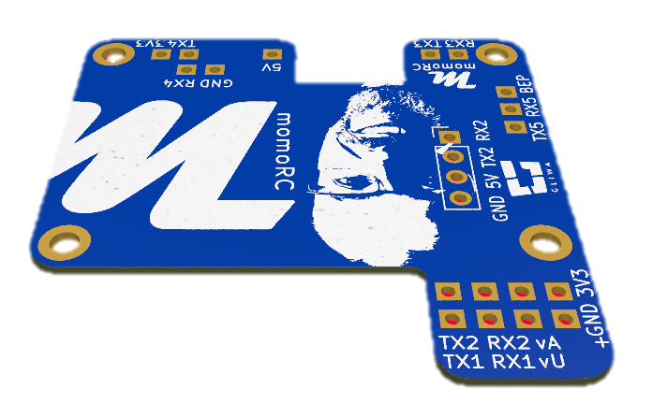
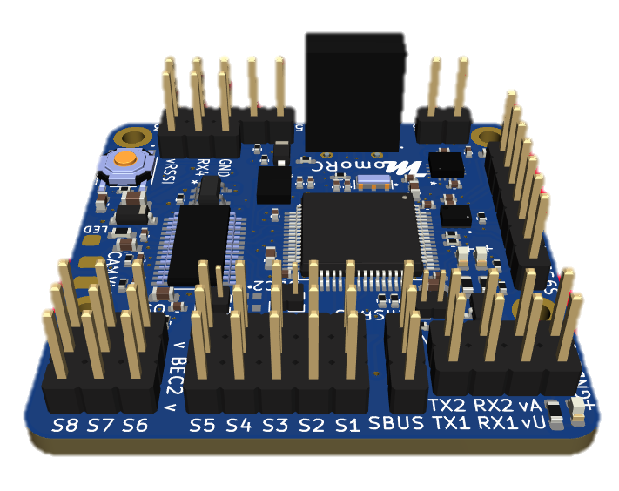
Hardware Documentation
FLIGHT CONTROLLER MOMOFC-1
STM32F405RGT6, BMI088, HMC5883L, DPS310, OSD, 5x UARTs, 1x I2C, 10x PWM, Dual BEC support, 2~5S LiPo
omoRC
Assembly Dir
Forward facing
(Recommended)
omoRC 2022
V1.0, 22.10.2022

